Slide 1

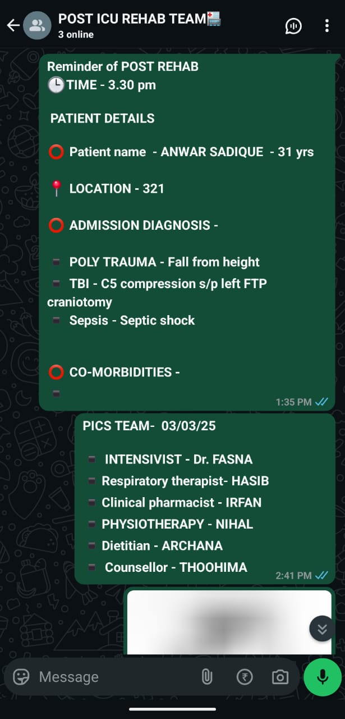
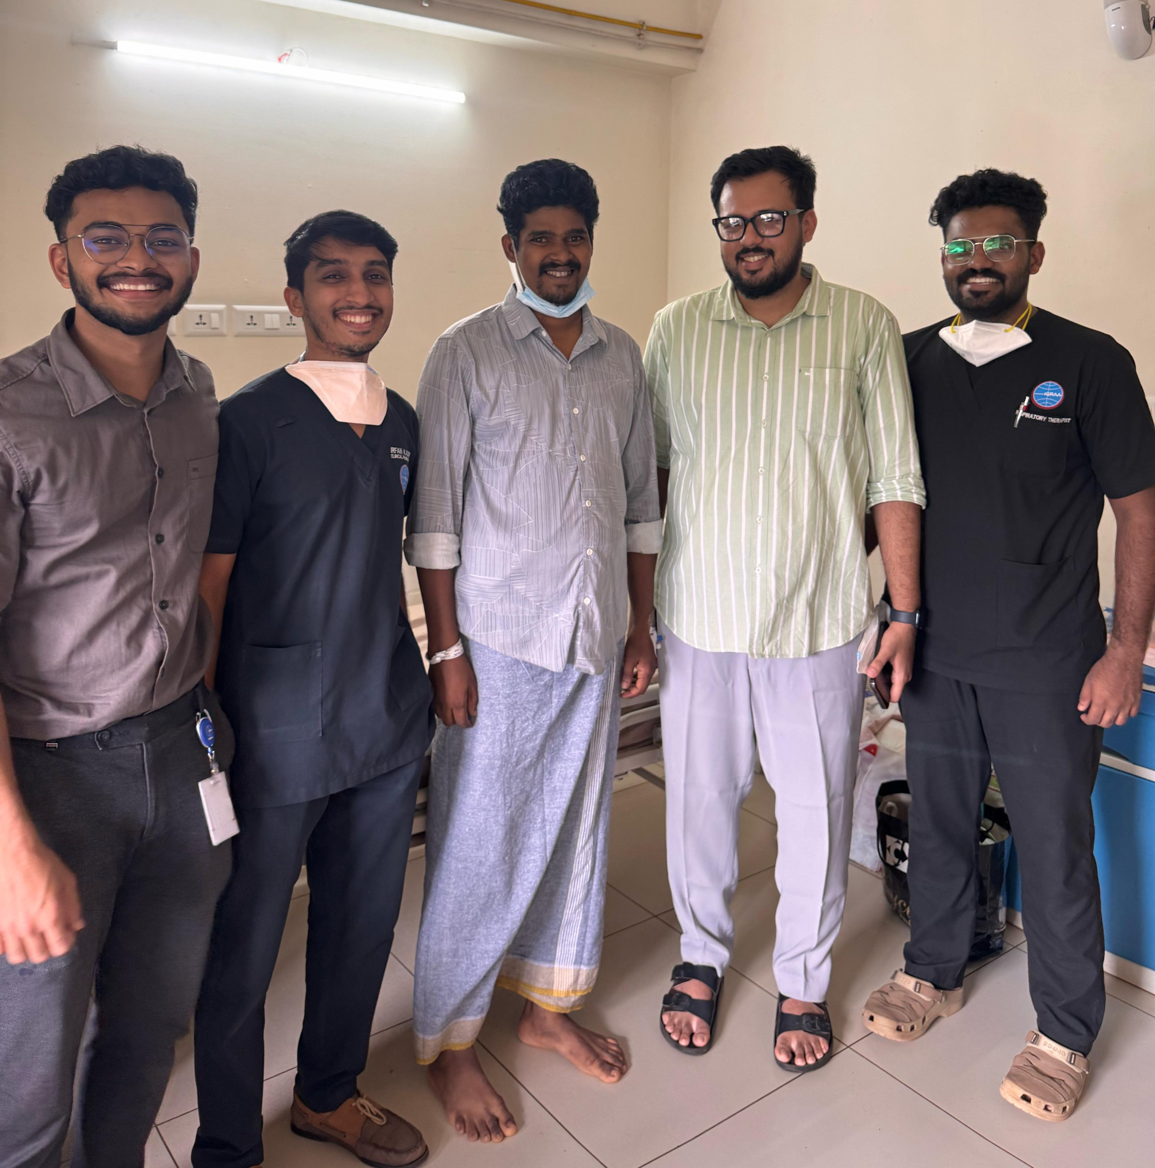
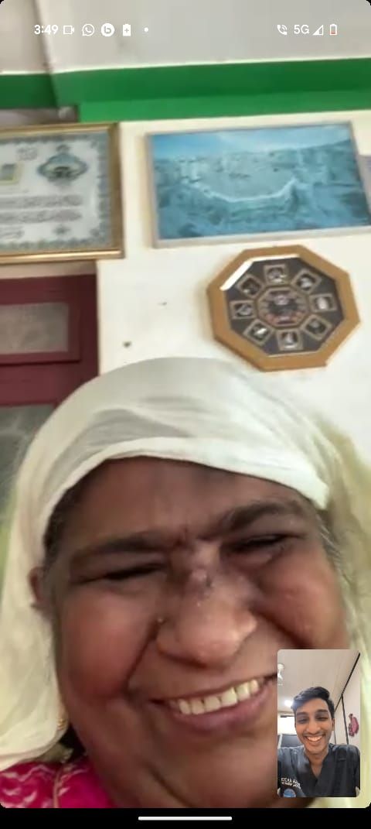
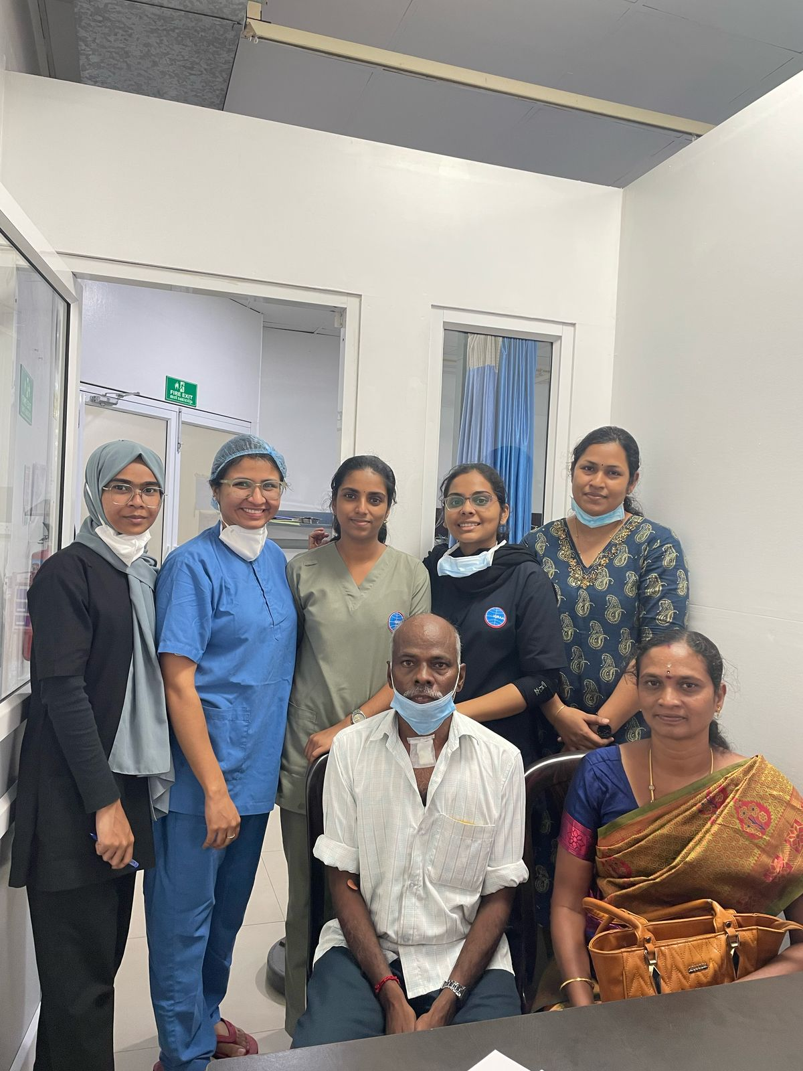

Transforming ICU recovery; our journey in post intensive care syndrome awareness, intervention and research
About the Organization
• Hospital Name: IQRAA International Hospital & Research Centre
• NABH Accreditation Number: H-2022-0981
• Address: Wayanad Road, Malaparamba, Calicut, Kerala, 673009
Contact Person-
• Name: Dr. Faris Hussain K N
• Designation: Consultant & Chief- Critical Care Medicine
• Email: farishussain2@gmail.com
• Mobile Number: +918848674731
• Hospital Category: 'Patient-Centric Digital Solutions'
Project Overview & Strategic Objectives
• Project/Initiative Title: Impact on Psychological heath and Health related quality of life in ICU survivors: A Prospective observational study
• Brief Summary: The Post-Intensive Care Syndrome (PICS) initiative addresses the long-term physical, cognitive, and psychological challenges faced by ICU survivors. This initiative aims to ensure meaningful recovery through structured, multidisciplinary post-ICU care.
Objectives: Primary Objective is to assess the Health-Related Quality-of-Life & Psychological health among ICU survivors at 6 months and 1-year post- discharge.
Outcomes: Significant improvements noted in HRQoL (SF-36), depression, and functional status over 12 months. Demonstrated that digital solutions enhance communication, patient engagement, and care coordination in post-ICU recovery.
• Implementation Period: December 2023- Ongoing
• Technology/Innovation Used: Tele follow-up for virtual consultation and Digital systems for score assessments
The PICS App was developed in-house.
• Key Objective: To ensure holistic and meaningful recovery of ICU survivors through multidisciplinary follow-up care.
Expected Benefit: Improved health-related quality of life (HRQoL), and enhanced continuity of care through digital tools, education, and patient-centered rehabilitation.
Feedback, Evidence & Acknowledgements
• Screenshots or Photos or Videos of the Initiative in Action [Add photos in ‘.jpg’ & videos in ‘.mp4’]
• Advantage of NABH accreditation: NABH focuses on continuum of care, patient-centered communication, early rehabilitation, and outcome monitoring. This has highlighted the need for structured follow-up for ICU survivors—many of whom suffer from Post-Intensive Care Syndrome (PICS). This motivated the adoption of digital platforms for early screening, remote monitoring, teleconsultations, and patient education after ICU discharge.
Digital innovations aligned with NABH standards have enabled:
Seamless transitions of care across departments
Real-time documentation and alerts for follow-up
Data-driven tracking of patient outcomes post-discharge.
Challenges, Outcomes, and Future Scalability
• Challenges Faced & How They Were Overcome: Around 70% of ICU patients are at risk of developing PICS (Post Intensive Care Syndrome). Effective management requires a multidisciplinary approach, yet awareness of PICS & PICS-F (Family) remains low. A tele follow-ups led by a multidisciplinary team including a doctor, clinical pharmacist, respiratory therapist, dietitian & a psychologist was implemented.
• Impact & Measurable Outcomes: Streamlined follow-up, improved recovery outcomes, cut readmissions, reduced costs, and achieved near-total compliance.
• Sustainability & Scalability: Leverages existing resources, integrate into standard care, educate patients. Use digital tools like apps, standardized protocols, broad clinician training.
Notes:
Speaker notes
XXXXX
XXXXX
XXXXX
XXXXX
XXXXX
XXXXX
XXXXX
XXXXX
XXXXX

Slide 2
NABH Digital Health Excellence Awards Submission –
Detailed Slides
Project Overview & Strategic Objectives – Digital Health Excellence Initiative
• Project/Initiative Title: Impact on Psychological Heath and Health Related Quality of Life in ICU Survivors: A Prospective Observational Study.
Brief Summary (Overview of the Initiatives, Objectives and its Outcome):
The Post-Intensive Care Syndrome (PICS) initiative was launched to address long-term physical, cognitive, and psychological impairments that affect 30–50% of ICU survivors and their families (PICS-F). While ICU survival rates have improved, many patients face persistent disabilities, mental health issues, and reduced quality of life. This program integrates a multidisciplinary follow-up model into routine ICU discharge protocols, ensuring smooth transitions from ICU to ward to home or rehabilitation. Key components include an institutional PICS WhatsApp group for real-time communication, awareness materials for staff and patients, structured PICS rounds, outpatient clinics, teleconsultations, home visits, and a mobile app under development for remote monitoring and rehabilitation tracking.
Identify and address PICS symptoms early to prevent chronic disability.
Ensure continuity of care through multidisciplinary follow-up.
Improve awareness among healthcare providers and the public.
Use digital tools and telemedicine to enhance accessibility and monitoring.
Generate data to guide evidence-based post-ICU care.
Over 200 ICU survivors have received structured follow-up care. Health-related quality of life (SF-36) improved from a median score of 45 to 65 at 12 months, depression scores decreased from 22 to 15, and functional independence (Katz ADL) increased from 2 to 6. Readmissions reduced by ~20%, while tele-follow-ups saved patients ₹2,500–₹5,000 each and avoided hospital costs of ₹50000-1 lakh annually. Compliance with PICS discharge protocols reached 100%, supported by staff training and patient education initiatives. The model is sustainable, cost-effective, and scalable to other healthcare settings.
Initiated on December 2023- Ongoing
Overview
Objectives
Outcomes
Implementation Period
Notes:
Speaker notes
XXXXX
XXXXX
XXXXX
XXXXX
XXXXX
XXXXX
XXXXX
XXXXX
XXXXX

Slide 3
NABH Digital Health Excellence Awards Submission –
Detailed Slides
Project Overview & Strategic Objectives – Digital Health Excellence Initiative
Institutional PICS WhatsApp Group: Real-time communication between ICU & ward teams, Ensures continuity of care and unbiased plan execution.
Telemedicine & Virtual Consultations: Follow-up calls & video consults for remote monitoring, Early intervention to prevent readmissions.
Electronic Medical Records (EMR): Structured PICS assessment templates, Progress tracking & secure multidisciplinary access.
Cybersecurity Measures: Encrypted messaging for sensitive patient data, Restricted access & secure cloud backup.
Patient Education Tools: Awareness video in Malayalam + English subtitles, Digital PICS information cards for survivors & families.
PICS Mobile Application (Under Development): Symptom tracking & rehabilitation reminders, Medication alerts & secure patient–care team messaging.
Key Objectives:
Identify & address physical, cognitive, and psychological impairments in ICU survivors and their families (PICS & PICS-F).
Ensure smooth care transition from ICU → ward → home/ rehabilitation.
Provide early assessment & targeted interventions to prevent chronic disability.
Increase awareness of PICS among healthcare providers and the community.
Establish multidisciplinary follow-up care as a routine part of ICU recovery.
Leverage digital tools & telemedicine to improve accessibility and continuity of care.
Generate research data to guide evidence-based post-ICU practices.
Improved recovery rates and quality of life in ICU survivors.
Reduced hospital readmissions through proactive monitoring and follow-up.
Better functional independence and psychological well-being.
Enhanced patient & family satisfaction with recovery support.
Greater awareness and early recognition of PICS in clinical practice.
Data-driven insights for optimizing post-ICU rehabilitation strategies.
Scalable model for other institutions to adopt post-ICU care programs.
Technology/ Innovation Used
Primary Goals
Expected Benefits
Notes:
Speaker notes
XXXXX
XXXXX
XXXXX
XXXXX
XXXXX
XXXXX
XXXXX
XXXXX
XXXXX

Slide 4
NABH Digital Health Excellence Awards Submission
- Detailed Slides
Challenges, Outcomes, and Future Scalability
Low awareness among healthcare providers and patients about PICS.
Limited resources for post-ICU rehabilitation, including mental health support.
Resistance to change in integrating PICS follow-up into routine practice.
Communication gaps between ICU, ward, and post-discharge care teams.
Socio-economic barriers limiting patient follow-up and access to care.
Data management difficulties for tracking long-term patient outcomes.
Conducted awareness campaigns with posters, videos, and training sessions.
Established a multidisciplinary follow-up team including physiotherapists, psychologists, and pharmacists.
Created institutional protocols making PICS rounds and follow-ups a standard of care.
Formed an ICU–ward WhatsApp group for real-time communication and care planning.
Introduced teleconsultations and home visits to reach patients with financial or mobility constraints.
Adopted EMR-based tracking for structured assessments and long-term monitoring.
Efficiency Gains: Reduced follow-up delays through institutional WhatsApp group → Average time from ICU discharge to first follow-up reduced from ~4 weeks to 1 week, EMR-based PICS templates streamlined documentation, cutting assessment time by 30%.
Patient Care Improvements: 200+ patients received structured PICS follow-up care (OPD, teleconsultations, home visits), Significant improvement in HRQoL (SF-36 median score: 45 → 65 in 12 months), Depression scores decreased (BDI median: 22 → 15) and functional independence improved (Katz ADL median: 2 → 6), Early recognition and intervention reduced avoidable readmissions by ~20%.
Cost Savings: Telemedicine follow-ups saved an estimated ₹2,500–₹5,000 per patient in travel and lost wages, Reduced readmissions led to estimated hospital cost avoidance of ₹50000-1 lakh annually.
Compliance & Standardization: 100% of ICU discharges now receive a PICS card and follow-up plan, Multidisciplinary rounds and EMR documentation compliance improved from 60% to 95%. Awareness coverage: posters installed in 5+ high-traffic clinical areas; video reaches ~500+ viewers/month., etc.]
Challenges Faced
How They Were Overcome
Impact & Measurable Outcomes
Notes:
Speaker notes
XXXXX
XXXXX
XXXXX
XXXXX
XXXXX
XXXXX
XXXXX
XXXXX
XXXXX

Slide 5
NABH Digital Health Excellence Awards Submission
- Detailed Slides
Challenges, Outcomes, and Future Scalability
Sustainability & Scalability:
Integrated into routine ICU discharge protocols, making follow-up care standard practice.
Multidisciplinary team uses existing staff (physiotherapists, psychologists, pharmacists) to minimize extra manpower needs.
Low-cost digital tools (WhatsApp, teleconsultations, EMR templates) keep operational expenses minimal.
Ongoing staff training, patient awareness campaigns, and integration into hospital quality frameworks ensure continued support.
Upcoming PICS mobile app will automate follow-ups, symptom tracking, and reminders, reducing manual workload.
Flexible structure adaptable to all hospital settings—from tertiary care to smaller district hospitals.
Follow-up schedules, team size, and technology use can be tailored to available resources.
Telemedicine and digital engagement tools enable expansion beyond geographic boundaries.
Standardized EMR templates, educational materials, and training modules support rapid, consistent adoption.
Multi-center data collection can drive large-scale research, attract funding, and inform policy for nationwide post-ICU care.
Sustainability
Scalability
Notes:
Speaker notes
XXXXX
XXXXX
XXXXX
XXXXX
XXXXX
XXXXX
XXXXX
XXXXX
XXXXX

Slide 6


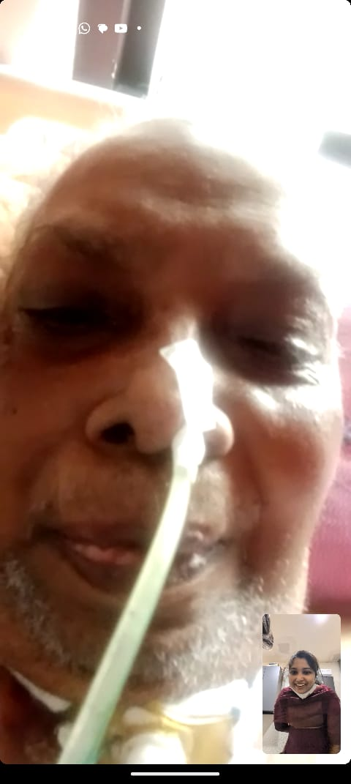
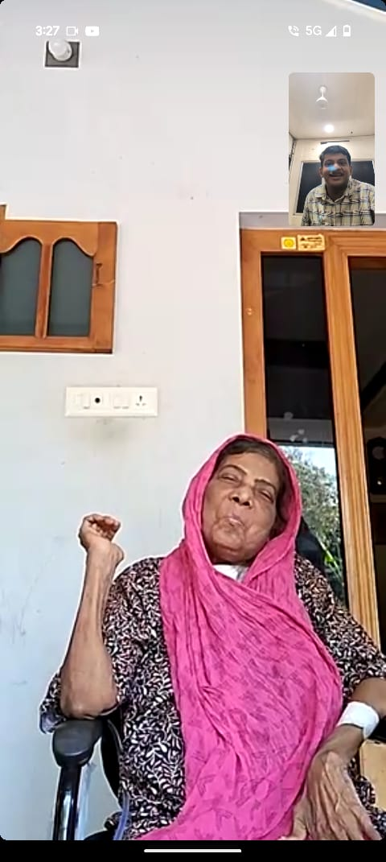
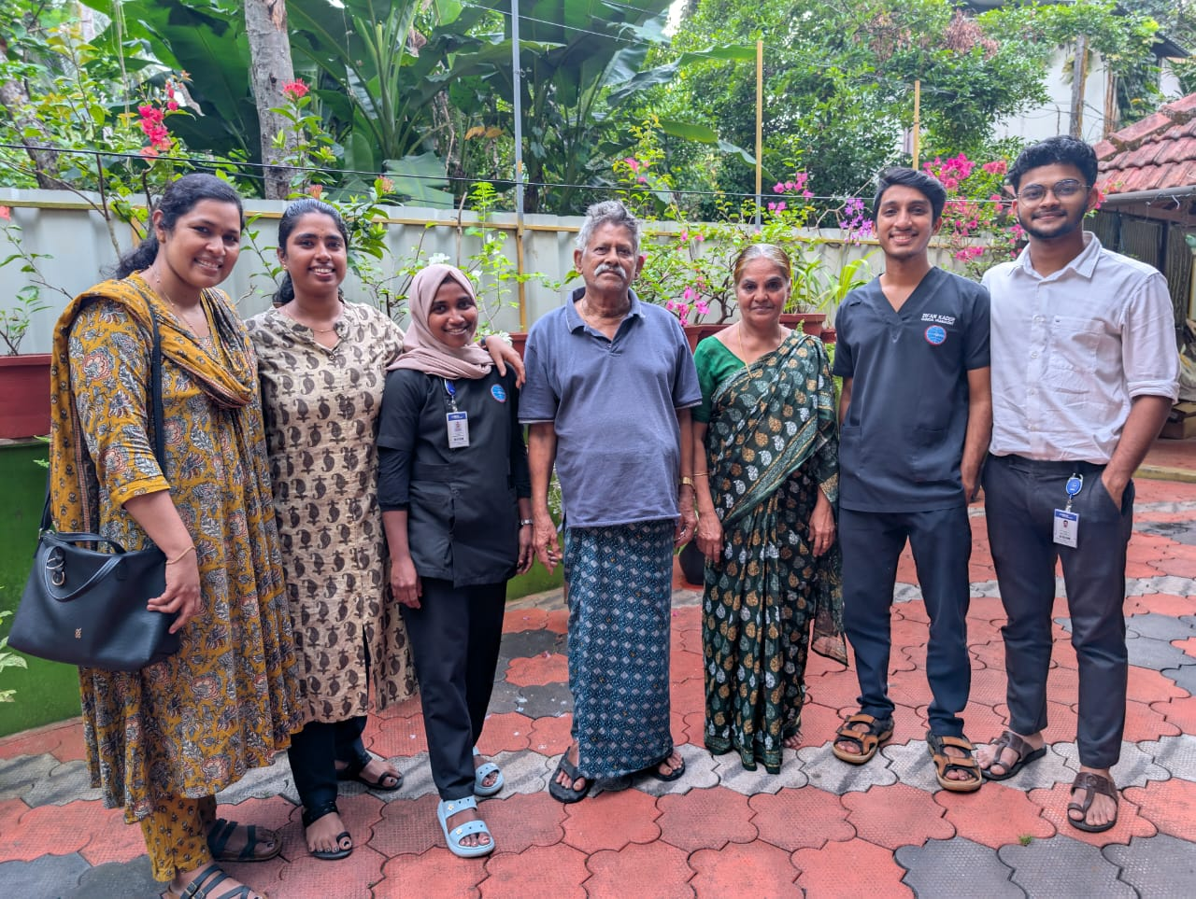
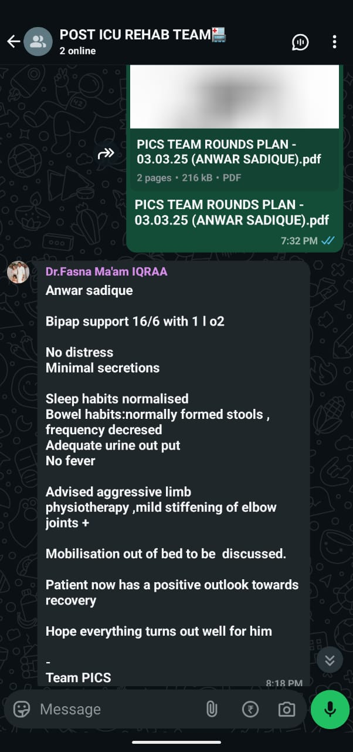
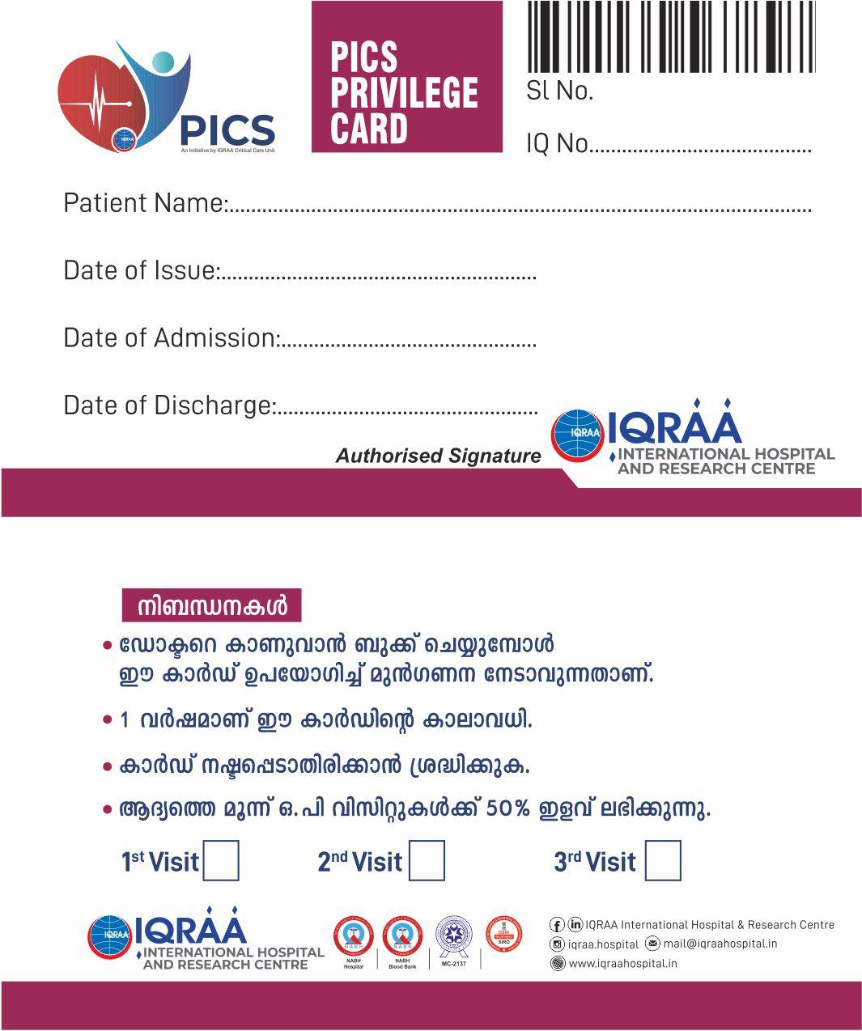
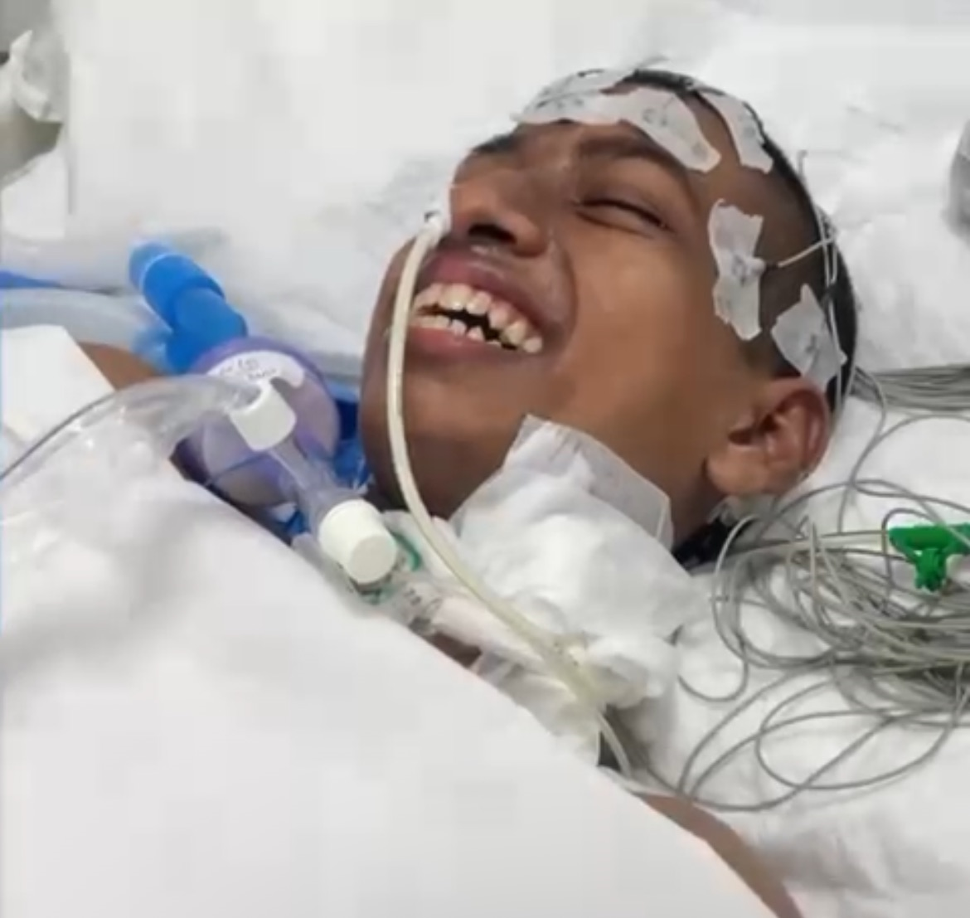



NABH Digital Health Excellence Awards Submission
- Detailed Slides
Feedback, Evidence & Acknowledgements
• Screenshots or Photos or Videos of the Initiative in Action: Detailed Project https://docs.google.com/presentation/d/1_BBdi7yTHf3iNpXSdKSEuY9-wkYV1hvi/edit?usp=sharing&ouid=102844675638665587240&rtpof=true&sd=true
Notes:
Speaker notes
XXXXX
XXXXX
XXXXX
XXXXX
XXXXX
XXXXX
XXXXX
XXXXX
XXXXX

Slide 7
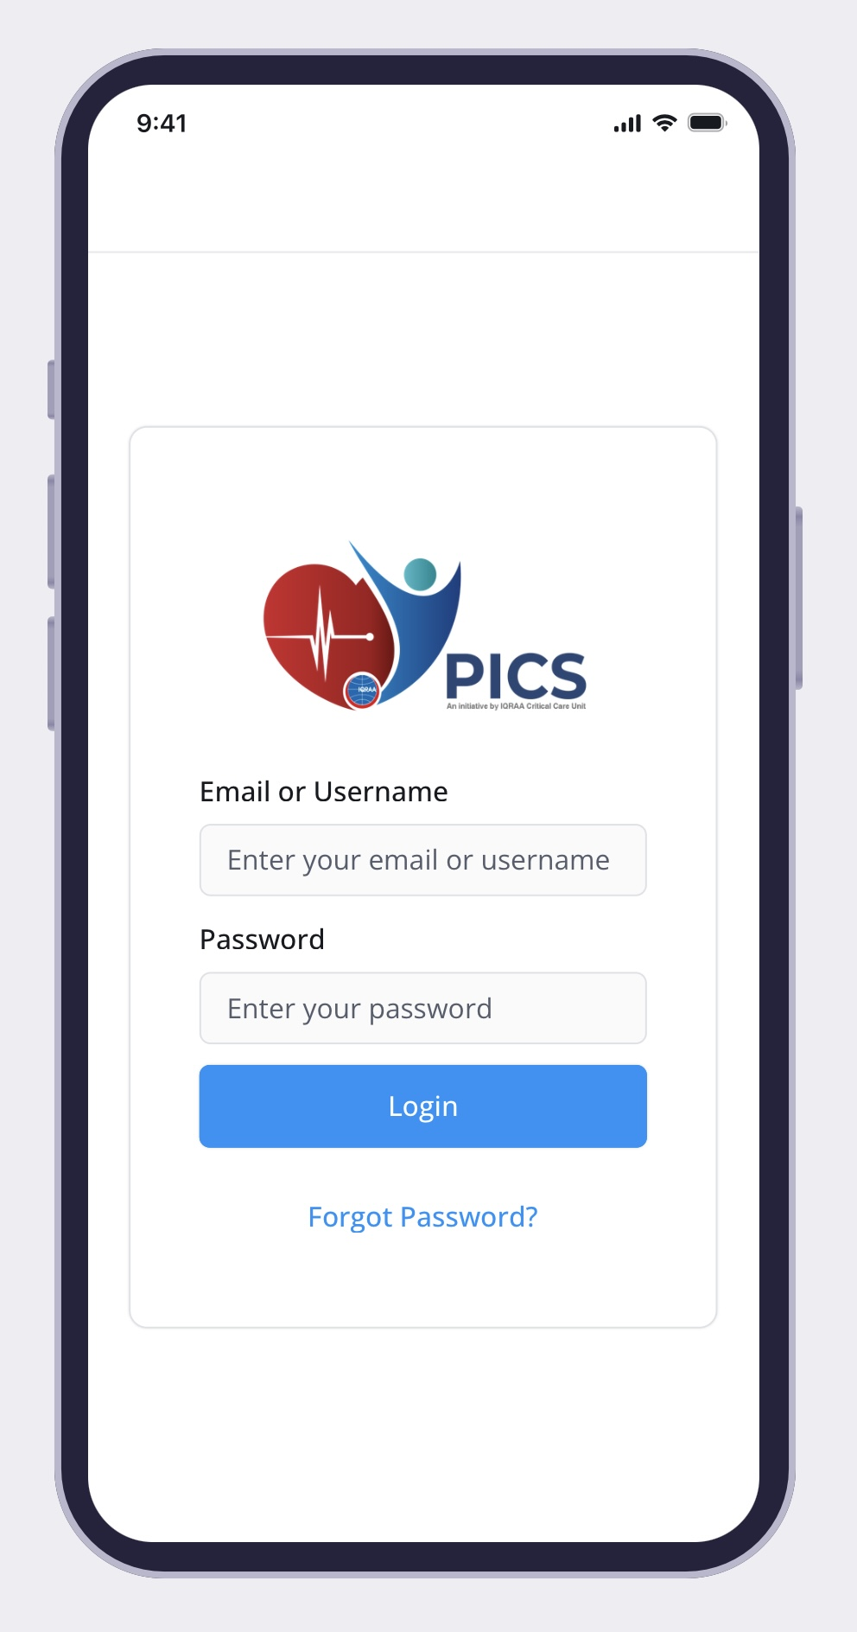
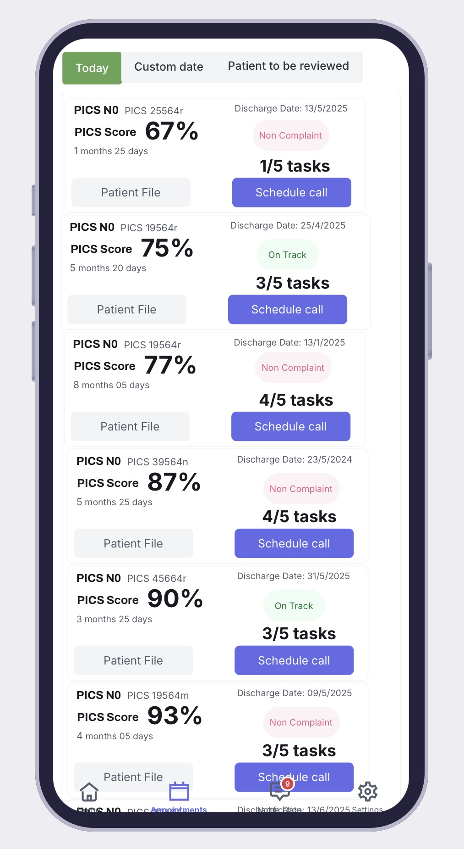
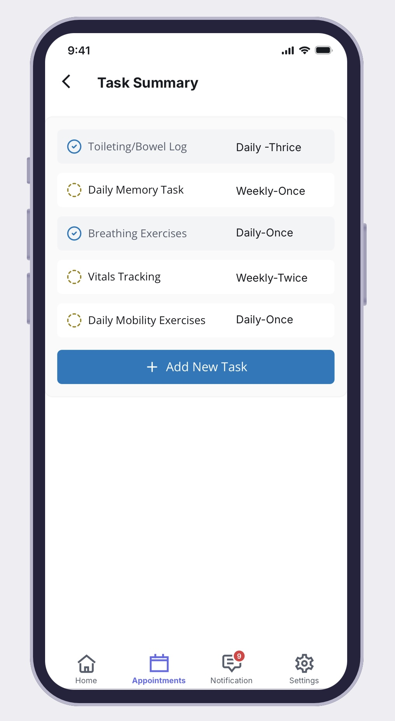
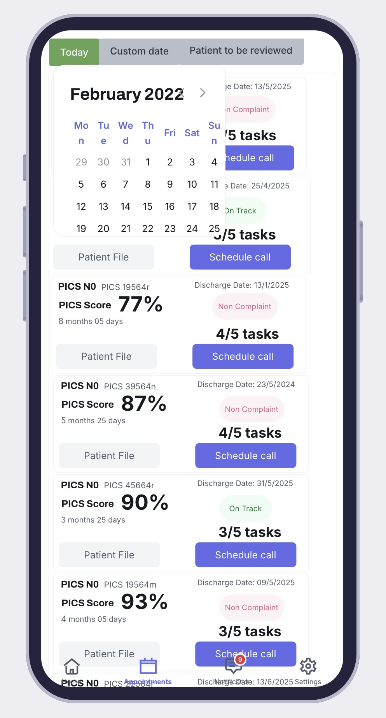
NABH Digital Health Excellence Awards Submission
- Detailed Slides
Feedback, Evidence & Acknowledgements
Advantage of NABH Accreditation:
Key NABH standards that influenced this innovation include:
– Assessment & Continuity of Care: Focuses on individualized care planning. The digital platform enabled personalized PICS risk assessments, rehabilitation plans, and ongoing virtual support post-discharge.
– Continuity of Care: Emphasizes the need for coordinated care during transitions, especially at discharge. This prompted the integration of digital tools to ensure timely follow-up and structured monitoring of ICU survivors at risk for PICS.
– Patient Education and Involvement: Encouraged the development of patient-facing digital interfaces to educate patients and families about PICS, self-care, and when to seek help.
– Use of Information Management Systems: This standard inspired the use of electronic documentation, dashboards, and automated alerts to track patient progress and support clinical decisions related to PICS.
– Monitoring Quality Indicators: Facilitated the inclusion of data analytics to measure post-ICU outcomes, readmission rates, and effectiveness of interventions, supporting quality improvement initiatives.
By aligning with these NABH standards, the digital PICS platform ensured compliance, enhanced patient safety, and bridged critical gaps in post-ICU care, ultimately supporting a culture of continuous quality improvement.
PICS App Prototype
AAC
COP
PRE
IMS
PSQ
Notes:
Speaker notes
XXXXX
XXXXX
XXXXX
XXXXX
XXXXX
XXXXX
XXXXX
XXXXX
XXXXX

