Slide 1

Digital Transformation - National Cancer Institute
About the Organization
National Cancer Institute (NCI), Nagpur is a tertiary care oncology hospital dedicated to comprehensive cancer diagnosis, treatment, and research.
Type & size of hospital: Tertiary Care / 470 beds
Location, specialties/user base: Nagpur, MH
Type of Accreditation /Certification: NABL
Contact details to know more: Milind Somalwar (7499162664)
Digital Tool / Solution Implemented
National Cancer Institute implemented the MEDNET Oncology EMR, a specialized digital platform designed to manage the complex clinical workflows involved in cancer diagnosis and treatment. The system integrates patient information across multiple oncology departments, enabling clinicians to access complete medical records, diagnostic reports, and treatment plans through a unified digital interface.
Key Functional Capabilities
Centralized patient record combining consultations, investigations, and treatment history
Seamless access to pathology, imaging, laboratory reports, and medication records
Single-screen view of patient oncology history
Displays previous consultations, chemotherapy cycles, diagnostic findings, and treatment responses
Standardized chemotherapy protocols
Automatic dosage calculations based on Body Surface Area (BSA)
Cycle tracking and treatment documentation
Recording of vitals, treatment observations, and laboratory trends
Progress notes and treatment response documentation
Standardized chemotherapy ordering
Dosage safety alerts
Treatment verification before administration
The digital oncology system ensures coordinated cancer care, improved clinical decision-making, and safer chemotherapy management, while maintaining a longitudinal digital record of each patient’s cancer journey.
Digital Implementation Highlight
The MEDNET Oncology EMR was implemented at NCI as part of the hospital’s digital transformation initiative.
Implementation Highlights
System rollout completed in phased deployment across oncology departments
Covered departments including:
Medical Oncology
Radiation Oncology
Pathology
Diagnostics
Pharmacy
Accounts & finance
Supply chain and inventory
Comprehensive training programs conducted for clinicians, nurses, and pharmacists
Clinical workflows were redesigned to support digital documentation and treatment protocols
Key Implementation Enablers
Strong leadership support from hospital management
Dedicated clinical champions from oncology departments
Continuous training and user adoption programs
Integration with diagnostic and laboratory systems The implementation successfully enabled digitally coordinated oncology care delivery across departments.
Problem Statement / Digital Challenge
Oncology decisions require reviewing large volumes of clinical data
Patient information scattered across diagnostics and treatment records
Delays in clinical review and treatment planning
Need for unified digital view of patient journey
Notes:
Speaker notes
XXXXX
XXXXX
XXXXX
XXXXX
XXXXX
XXXXX
XXXXX
XXXXX
XXXXX

Slide 2
Digital Transformation - National Cancer Institute
Digital Impact: The digital oncology system has significantly improved the efficiency, safety, and coordination of cancer care delivery at National Cancer Institute.
Faster transition from diagnosis to treatment planning
Complete visibility of patient oncology history
Improved clinical decision-making through consolidated clinical data
Structured documentation of chemotherapy protocols and treatment cycles
Automated drug dosage calculations
Safety alerts during chemotherapy ordering
Treatment verification prior to drug administration
Reduced risk of medication errors
Better coordination between oncologists, nurses, and pharmacists
Real-time monitoring of treatment progress
Improved tracking of chemotherapy utilization
Digital documentation supporting clinical audits
NABH Alignment: The digital oncology system strengthens compliance with NABH standards by -
Ensuring complete clinical documentation
Enhancing patient safety during chemotherapy administration
Supporting traceability of treatment decisions
Improving audit readiness and quality monitoring
Key Enablers /Innovations: The success of the digital oncology transformation at NCI was driven by a combination of technology, clinical leadership, and process redesign.
Specialized Oncology EMR: Unlike generic hospital systems, the MEDNET platform was designed specifically to support oncology workflows including chemotherapy protocols, cycle tracking, and treatment monitoring.
Integrated Diagnostic Data: Pathology reports, imaging studies, and laboratory results are directly accessible within the oncology record, allowing clinicians to review complete diagnostic information before initiating treatment.
Clinical Summary Dashboard: A consolidated clinical view enables oncologists to quickly review of Treatment history, Previous chemotherapy cycles, Diagnostic findings, Laboratory trends, Medication history
This significantly improves treatment planning and follow-up care.
Digital Chemotherapy Management: The system standardizes chemotherapy protocols and automates dosage calculations based on patient parameters, ensuring accuracy and consistency across treatment cycles.
Collaborative Care Model: A shared digital record enables seamless collaboration between oncologists, nurses, pharmacists, and diagnostic teams.
Challenges Addressed
Transition from paper-based documentation
Clinician adoption of digital workflows
Standardization of chemotherapy protocols
With continuous training and leadership support, the hospital successfully adopted a fully digital oncology treatment workflow.
Key Learnings/ Lessons Learned / Replicability
Specialized clinical systems are essential for complex specialties like oncology, where treatment protocols and long-term monitoring are critical.
Clinician engagement during implementation significantly improves system adoption.
Integrated digital records improve both clinical decision-making and treatment safety.
Replicability for Other Hospitals
Hospitals planning similar digital transformation initiatives should:
Select solutions tailored to their specialty workflows
Involve clinicians in system design and implementation
Ensure comprehensive staff training programs
Integrate diagnostics, pharmacy, and clinical modules
By adopting integrated oncology EMR systems, hospitals can significantly improve patient safety, treatment coordination, and clinical documentation quality.
Annexures and Supporting Documents
Uploaded
Notes:
Speaker notes
XXXXX
XXXXX
XXXXX
XXXXX
XXXXX
XXXXX
XXXXX
XXXXX
XXXXX

Slide 3
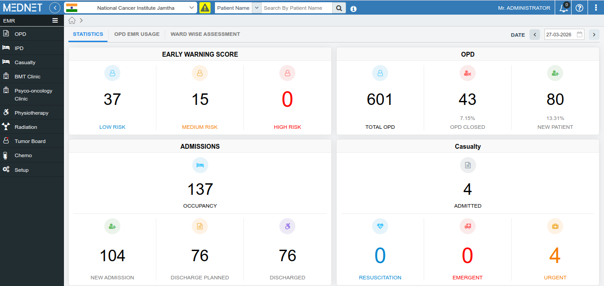
Digital Transformation - National Cancer Institute

