Slide 1

Digital Transofmation Story: Sevasadan Hospital
About the Organization
Sevasadan Lifeline Superspeciality Hospital is part of a multi-unit healthcare network providing comprehensive clinical services across multiple locations.
Type & size of hospital: Tertiary Care (3 units with total 475 beds)
Location, specialties/user base: Miraj, Maharashtra
Type of Accreditation /Certification: Digital Standard Silver Level and NABH 5th Level Accreditation
Contact details to know more: Chetan Kadole (8999359701)
Digital Tool / Solution Implemented: Sevasadan Lifeline Superspeciality Hospital implemented the MEDNET Hospital Information System (HIS) to digitally connect patient care, clinical workflows, and operational processes across all hospitals within the healthcare group. The centralized digital platform allows hospitals within the network to function as a connected healthcare ecosystem, enabling seamless sharing of patient records and clinical information across locations.
Key Functional Capabilities
Unified Patient Record Across Hospital Network
Single digital patient record accessible across all hospitals
Consolidated access to consultations, diagnostic reports, and treatment history
Integrated Outpatient Care
Doctors can review complete patient history across different hospital units
Access to past consultations, medications, allergies, and procedures
Network-wide Diagnostic Integration
Electronic ordering of laboratory and imaging tests
Diagnostic reports automatically uploaded into the patient’s digital record
Reports accessible across all hospitals in the network
Coordinated Inpatient Care
Electronic treatment orders by physicians
Digital nursing documentation
Real-time medication administration records
Integrated diagnostic and procedure requests
Internal Referral Management
Seamless patient referrals between hospitals within the network
Instant access to prior investigations and treatment history
The centralized HIS ensures continuity of care, improved clinical coordination, and efficient information sharing across the entire hospital network.
Digital Implementation Highlight
The MEDNET Hospital Information System was deployed to digitally connect multiple hospitals within the Sevasadan healthcare network.
Implementation Highlights
Centralized HIS implemented across multiple hospital units
Integration of clinical departments including:
Outpatient services
Inpatient care
Diagnostics
Pharmacy
Administration
Digital patient records accessible across all hospitals in the network
Training & Adoption
Structured training programs conducted for doctors, nurses, and administrative staff
Clinical workflows redesigned to support digital documentation
Continuous support and adoption monitoring
Leadership Support
Implementation guided by hospital leadership and IT teams
Collaboration between clinical departments to standardize workflows
The initiative enabled the hospital group to operate as a coordinated digital healthcare network.
Problem Statement / Digital Challenge: Patients within multi-unit hospital networks often receive care across different locations depending on specialty availability and referrals. Before implementing the centralized digital platform:
Patient records were maintained separately at each hospital
Clinicians had limited visibility into treatments provided at other units
Patients were required to carry physical medical records
Diagnostic investigations were often repeated due to lack of shared data
These challenges affected:
Doctors making clinical decisions
Nursing teams managing care continuity
Hospital administrators monitoring operations
Patients navigating multiple hospital visits
A centralized digital solution was required to enable continuity of care across the hospital network while improving clinical coordination and operational visibility.
Notes:
Speaker notes
XXXXX
XXXXX
XXXXX
XXXXX
XXXXX
XXXXX
XXXXX
XXXXX
XXXXX

Slide 2
Digital Transofmation Story: Sevasadan Hospital
Digital Impact: The centralized digital platform has significantly improved coordination of care and operational efficiency across the Sevasadan hospital network.
Clinical Impact
Doctors can access complete patient medical history across hospital units
Improved clinical decision-making through shared diagnostic information
Better continuity of care for patients visiting different hospitals in the network
Patient Experience Improvements
Patients no longer need to carry physical medical files
Reduced duplication of diagnostic investigations
Faster access to specialists within the hospital group
Operational Improvements
Improved coordination between hospitals
Better management of patient referrals within the network
Enhanced monitoring of hospital operations and resource utilization
Increased transparency in patient care processes
NABH Alignment
The digital platform supports NABH quality standards by:
Ensuring comprehensive and traceable clinical documentation
Improving patient safety through structured workflows
Strengthening coordination of care across multiple facilities
Enhancing audit readiness and operational transparency
Key Enablers /Innovations: The digital transformation of the Sevasadan hospital network was enabled by the adoption of a centralized Hospital Information System that integrates clinical workflows across multiple hospital units.
Key Enablers
Centralized Patient Record System: The MEDNET HIS enables a unified patient record accessible across all hospitals in the network. Clinicians can review consultations, investigations, and treatment history regardless of where the earlier care was provided.
Integrated Diagnostic Connectivity: Laboratory and imaging investigations ordered at any hospital unit are automatically uploaded into the patient’s digital record and can be accessed by clinicians across the network.
Digital Inpatient Care Management: Within inpatient settings, clinicians can place treatment orders electronically while nurses document vitals, care activities, and medication administration digitally. This ensures consistent documentation and coordinated care delivery.
Seamless Internal Referrals: Patients referred between hospitals within the network carry their complete digital medical history, enabling clinicians at the receiving hospital to immediately continue treatment without repeating investigations.
Operational Monitoring: Hospital administrators can monitor patient flow, bed utilization, and diagnostic service usage across the hospital network, enabling better operational planning and resource allocation.
Challenges Addressed
Fragmented patient records across hospital units
Limited coordination between facilities
Inefficient referral workflows
Through digital integration, the hospital network now operates as a connected healthcare ecosystem supporting coordinated patient care.
Key Learnings/ Lessons Learned / Replicability
A centralized digital system is essential for maintaining continuity of care across multi-hospital networks.
Shared access to patient information significantly improves clinical coordination between hospital units.
Digital integration reduces duplication of diagnostic investigations and improves patient experience.
Replicability for Other Hospitals
Hospital groups planning similar digital initiatives should:
Implement a centralized HIS accessible across all hospital units
Ensure diagnostic and clinical systems are fully integrated
Standardize workflows across hospitals within the network
Provide continuous training to clinical and administrative staff
Such digital ecosystems enable healthcare networks to deliver coordinated, safe, and patient-centered care across multiple facilities.
Annexures and Supporting Documents
Attached in the next slide
Notes:
Speaker notes
XXXXX
XXXXX
XXXXX
XXXXX
XXXXX
XXXXX
XXXXX
XXXXX
XXXXX

Slide 3
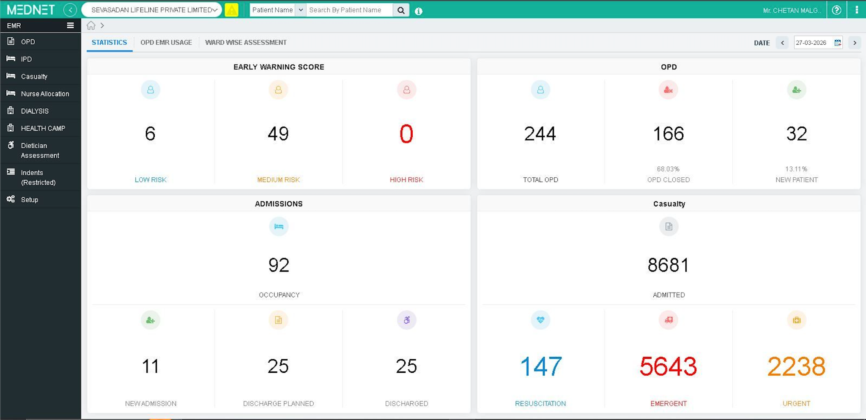
Digital Transofmation Story: Sevasadan Hospital

