Slide 1

Oncolife Cancer Center: Digital Transformation
About the Organization
Oncolife Cancer Center, Satara is a specialized oncology hospital focused on providing comprehensive cancer diagnosis and treatment services.
Type & size of hospital: Superspeciality /
Location, specialties/user base: Satara, Talegaon
Type of Accreditation /Certification: Entry level
Contact details to know more: Yashwant Kokate (7744024431)
Digital Tool / Solution Implemented: Oncolife Cancer Center implemented the MEDNET Hospital Information System (HIS) to support the complex clinical workflows involved in cancer diagnosis, treatment planning, and long-term patient monitoring.
Key Functional Capabilities
Creation of a comprehensive digital patient profile during registration
Captures demographic information, referral details, and clinical findings
Maintains a unified oncology patient record across departments
Radiology and pathology reports directly attached to patient records
Oncologists can review all diagnostic findings from a single interface
Enables faster and more accurate diagnosis
Digital documentation of chemotherapy schedules
Integration of radiotherapy plans and surgical interventions
Inclusion of supportive care protocols within treatment plans
Digital physician treatment orders
Nursing documentation of medication administration
Electronic laboratory requests and pharmacy integration
Continuous monitoring of treatment response
Documentation of laboratory parameters and adverse reactions
Ability to adjust therapy protocols based on patient response.
Digital Implementation Highlight:
The MEDNET Hospital Information System was implemented to digitize oncology workflows across the Oncolife Cancer Center.
Implementation Highlights
Deployment of a centralized digital platform supporting oncology workflows
Integration across departments including:
  Oncology consultations
  Diagnostics
  Inpatient care
  Pharmacy services
Creation of digital patient records for all oncology patients
Training and Adoption
Training programs conducted for oncologists, nurses, and administrative staff
Clinical workflows redesigned to support digital documentation
Continuous monitoring of system adoption and usage
Leadership Support
Implementation supported by hospital leadership and clinical teams
Collaboration between oncology specialists and IT teams ensured smooth rollout
The initiative enabled the hospital to establish a digitally coordinated oncology care model.
Problem Statement / Digital Challenge: Cancer treatment requires long-term coordination across multiple clinical departments including oncology, diagnostics, pharmacy, and inpatient care.
Before digital integration:
Patient records were often fragmented across departments
Diagnostic reports were not always instantly accessible
Treatment plans required manual documentation and coordination
Monitoring treatment response across multiple cycles was difficult
These challenges affected:
Oncologists managing complex treatment plans
Nursing teams coordinating patient care
Patients seeking clarity about treatment progress
A digital oncology platform was required to ensure continuity of care, structured treatment planning, and better coordination across departments while supporting NABH standards for patient safety and clinical documentation.
Notes:
Speaker notes
XXXXX
XXXXX
XXXXX
XXXXX
XXXXX
XXXXX
XXXXX
XXXXX
XXXXX

Slide 2
Oncolife Cancer Center: Digital Transformation
Digital Impact
The digital oncology platform has significantly improved coordination, transparency, and safety in cancer care delivery at Oncolife Cancer Center.
Clinical Impact
Oncologists can review complete patient history and diagnostic data in one system
Improved treatment planning through structured digital pathways
Better monitoring of treatment response across multiple therapy cycles
Patient Experience Improvements
Greater transparency in treatment plans
Improved communication between clinicians and patients
Patients receive coordinated care across diagnostic and treatment departments
Operational Improvements
Faster communication between doctors, nurses, laboratories, and pharmacy
Efficient management of chemotherapy and inpatient care workflows
Improved documentation of oncology treatment journeys
NABH Alignment
The digital oncology system supports NABH standards by:
Ensuring complete and structured clinical documentation
Improving patient safety through digital treatment workflows
Enhancing traceability of oncology treatment plans
Supporting quality monitoring and clinical audits
Key Enablers /Innovations
Comprehensive Digital Oncology Records: The MEDNET system creates a unified patient record beginning at registration and continues to document the entire cancer treatment journey, including diagnostics, therapy plans, and follow-up care.
Integrated Diagnostic Coordination: Radiology and pathology investigations are directly attached to the patient record, enabling oncologists to review all diagnostic findings simultaneously and make timely treatment decisions.
Structured Digital Treatment Pathways: The system allows clinicians to design and document structured oncology treatment plans including chemotherapy schedules, radiotherapy protocols, surgical interventions, and supportive therapies.
Digital Inpatient Coordination: During hospitalization, physicians record treatment orders digitally while nurses document medication administration and patient observations. Pharmacy and laboratory teams receive requests instantly through the system.
Continuous Treatment Monitoring: The platform preserves the entire treatment timeline, enabling clinicians to monitor patient response to therapy, manage side effects, and adjust treatment protocols when required.
Challenges Addressed
Fragmented patient records across departments
Limited visibility into treatment progress
Inefficient coordination between clinical teams
Through digital integration, the hospital has established a technology-supported oncology care ecosystem.
Key Learnings/ Lessons Learned / Replicability
Digital platforms significantly improve coordination in complex specialties such as oncology.
Structured treatment documentation enhances both patient safety and clinical decision-making.
Integrated diagnostic and treatment workflows reduce delays in cancer care.
Replicability for Other Hospitals
Hospitals planning similar initiatives should:
Implement oncology-focused digital systems
Integrate diagnostics, pharmacy, and inpatient care within a single platform
Ensure clinician involvement in system implementation
Conduct structured training programs for healthcare teams
Digital oncology platforms can help hospitals deliver coordinated, transparent, and patient-centric cancer care.
Annexures and Supporting Documents
Uploaded in the next slide
Notes:
Speaker notes
XXXXX
XXXXX
XXXXX
XXXXX
XXXXX
XXXXX
XXXXX
XXXXX
XXXXX

Slide 3
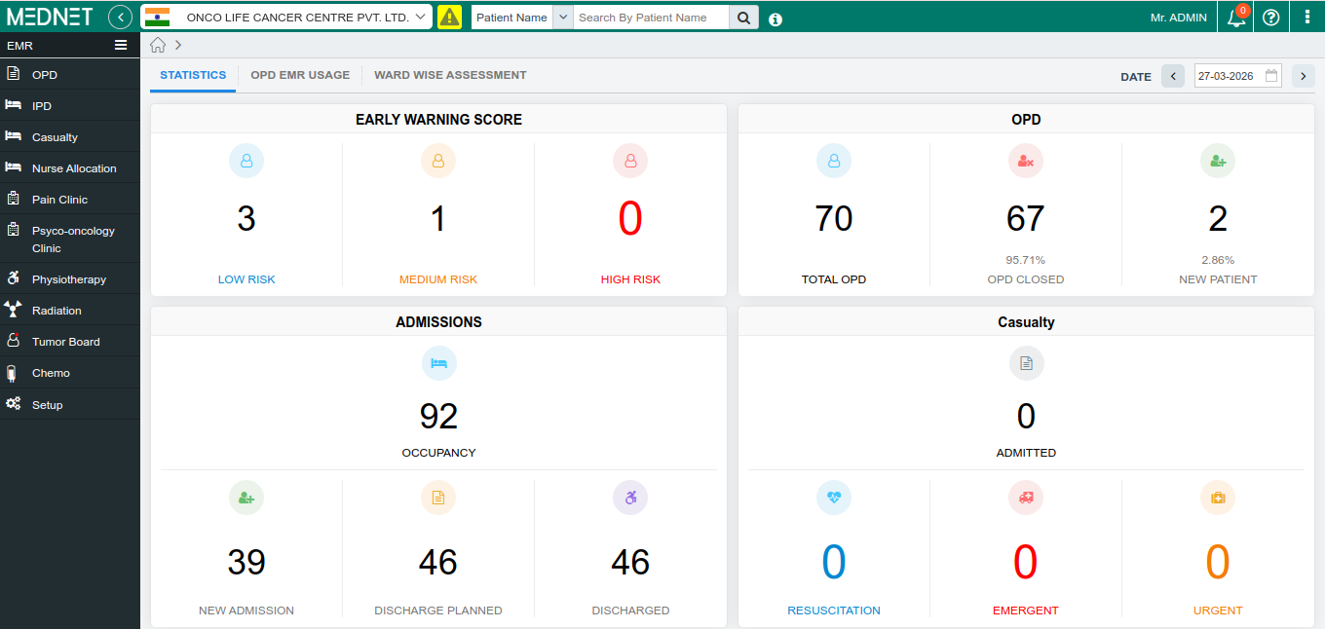
Oncolife Cancer Center: Digital Transformation

