Slide 1

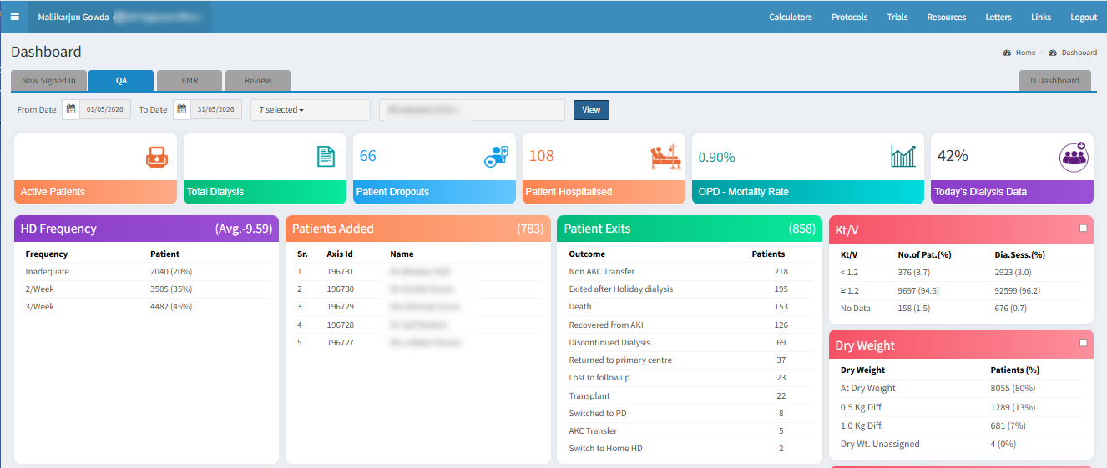
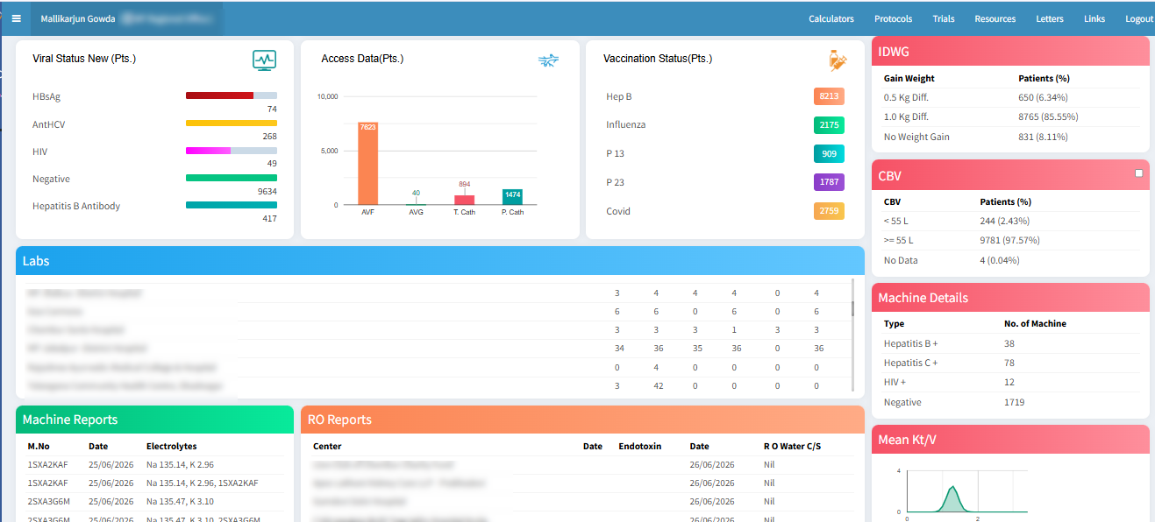
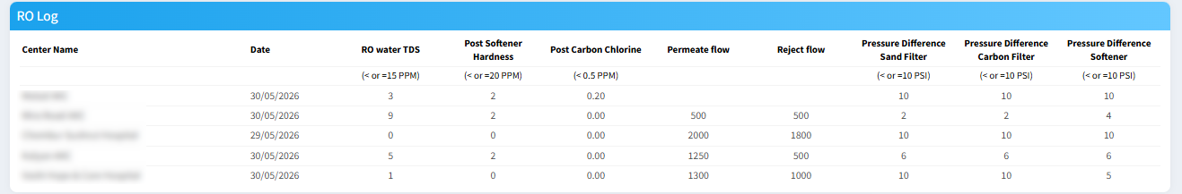

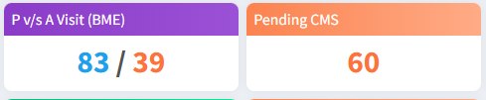
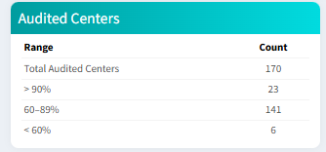
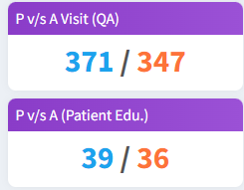
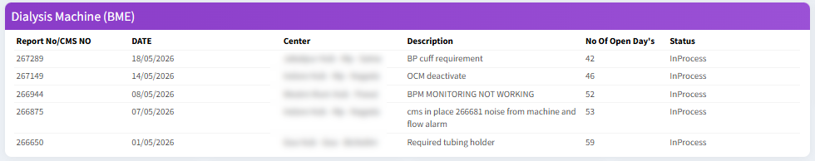
A Dashboard Approach to Quality Assurance for Dialysis centres
Objectives
To design & operate a system to monitor large numbers of dialysis patients at multiple centres across the country
Conclusions
Managing patients on hemodialysis to achieve desired outcomes is a hugely laborious and intensive process.
There are multiple data points which need to be monitored at multiple levels of authorization.
Digitising this data, visualizing it on a focused Dashboard and addressing treatment delivery shortcomings based upon the level of priority, is the only effective way to ensure that our patients don’t fall between the cracks.
The Apex Database

Slide 2
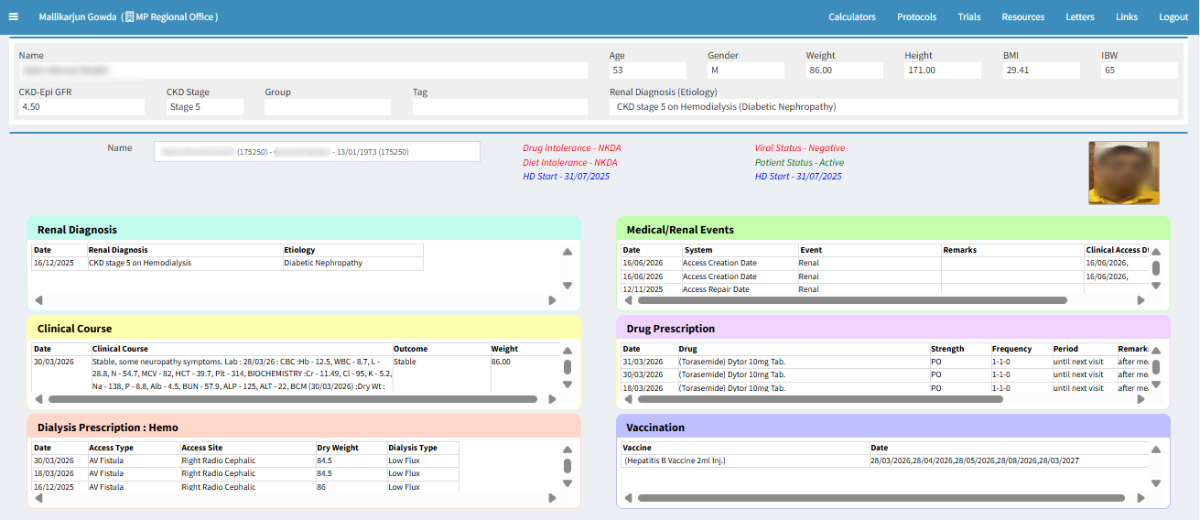
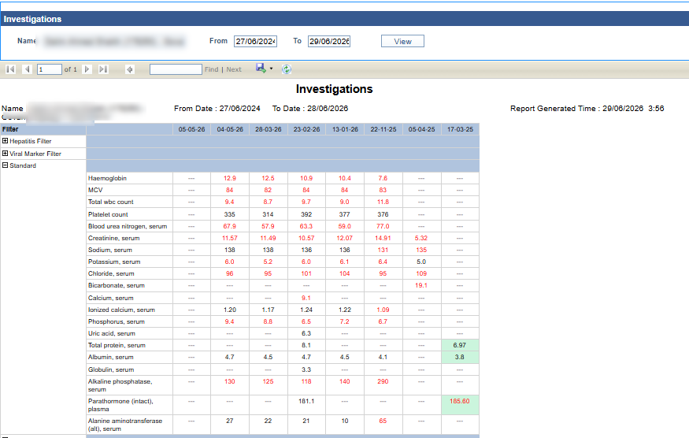
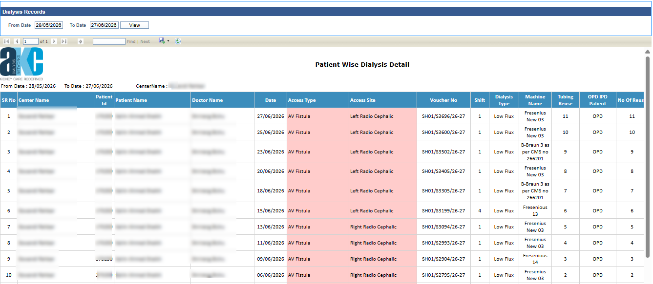
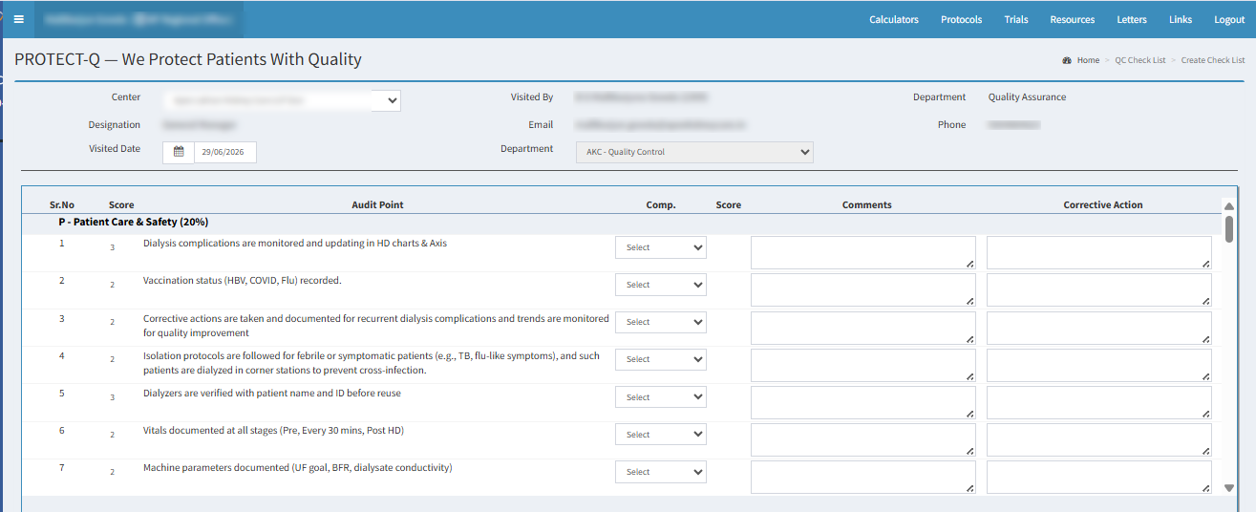
A Dashboard Approach to Quality Assurance for Dialysis centres
The Apex Database

