Slide 1


Presented by
Dr. Ajay Vasant Rotte
Medical Director

Slide 2


Slide 3


Slide 4


Slide 5
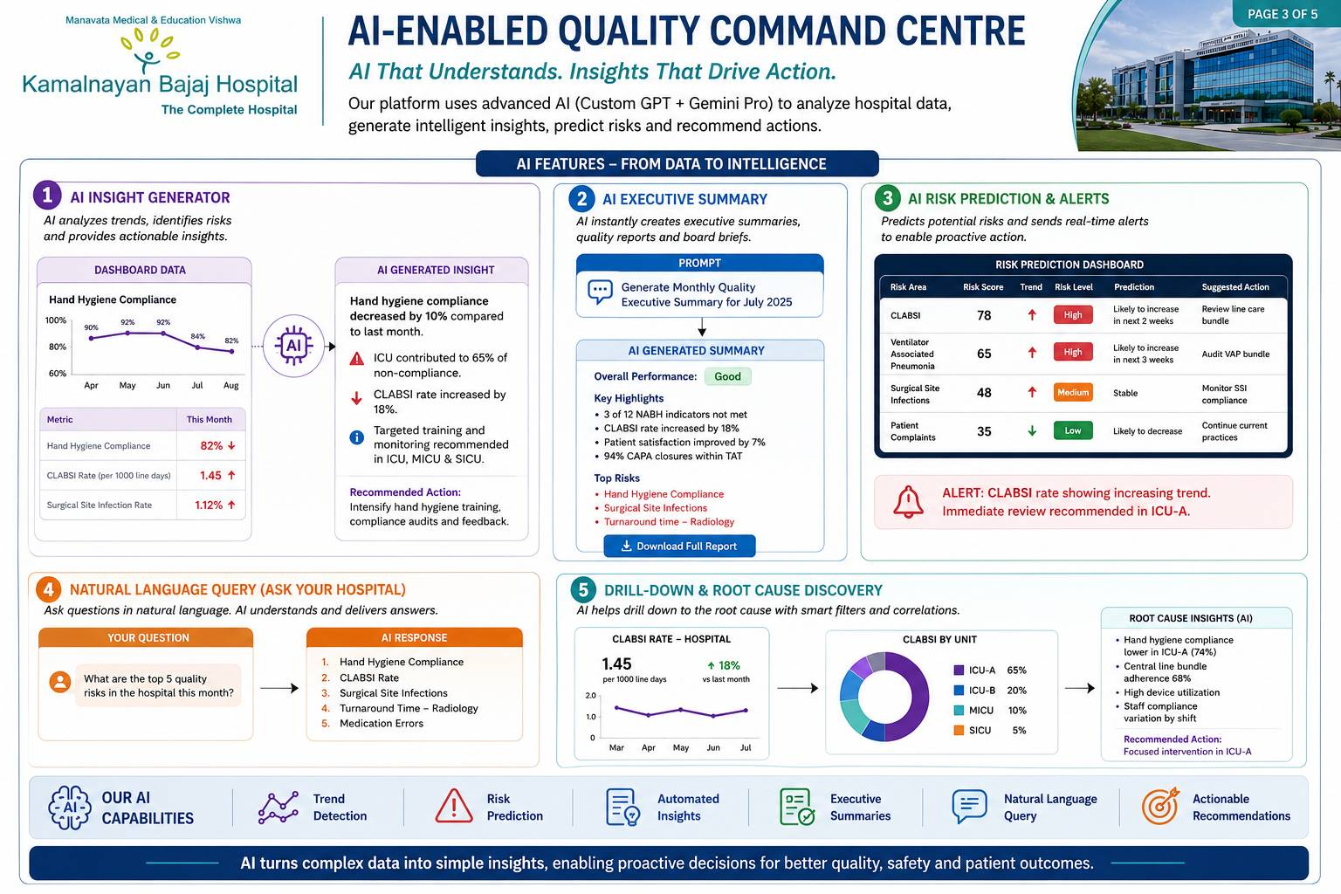

Slide 6


Slide 7


Slide 8


Slide 9


