Slide 1
Excellence in Digital Health

Slide 2
Computerized Hospital Records System (CPRS) for IPD
CPRS system makes the patient records available to authorized staff members by use of patient UHID number just at a click. These records can be accessed throughout the Max Chains.
The CPRS is integrated with E Prescription, Lab, Radiology and Blood Bank Information systems and provides links to these reports.
Effective & error free inter‐hospital information exchange is possible, as the records are electronic hence improving the Speed and efficiency.
The system also improves patient safety and human errors are eliminated in the process of exchange of information. As Bar Code medication administration is done and recorded into the CPRS, the system shows a pop up if wrong drug is dispensed or about to be administered to the patient.
CPRS also Improves clinician experience by providing easy access to patient health records, improved decision making using decision support systems.
CPRS system also reduces waste – going paperless and filmless. Paper and document expenses are cut to minimal. At Max Healthcare only documents that need signatures of patients are maintained in hard file.

Slide 3

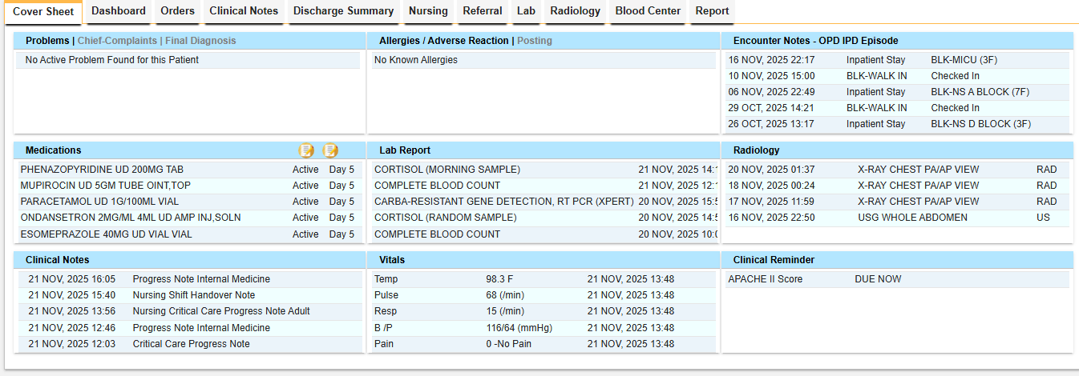
CPRS
Robust interoperability with other healthcare platforms enables smooth data flow and customizable user rights—including Read-Only, Edit/Addendum access.
Patient Cover Sheet/Snapshot with all details
Both outpatient and inpatient records are connected, ensuring complete patient data availability at a single location for treating medical practitioners.

Slide 4

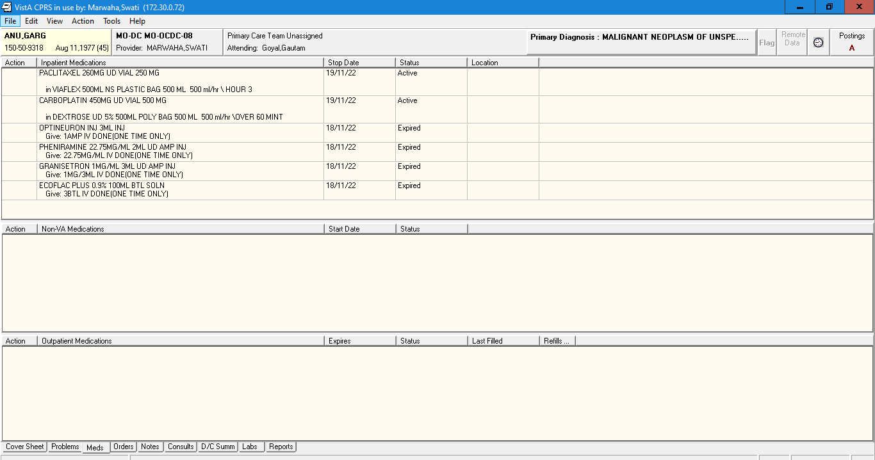
Medication Management
Our HIS-based Medication Management System maintains a real-time digital inventory of medicines and consumables, ensuring accurate stock visibility. The Pharmacy Module digitally records all medication dispensing—from pharmacy to ward—providing complete traceability, minimizing errors and enhancing patient safety.”
System blocks the medication administration in case the bar code does not match.

Slide 5
Bar Coded Medication Administration (BCMA) Benefits
Bar Code Medication Administration System
Stakeholders
For Patient- Lower the risk of Medication errors
Operations
Enhanced patient safety and better check on timings of drug administration due to system generated reports. Smoother operations due to decreased load of transpiring the drug in patient medical records after every drug administration. Better inventory control in Pharmacy.
Business
Lesser medication errors leading to enhanced patient care and outcomes, which in turn leads to better word of mouth and acceleration in business
For Nurses- Reduces the work load of transcription of drug administration
For Doctor- Better control of timings of drug administration and lesser chances of medication error leading to better patient outcomes
For administration- Enhanced patient safety and better check on timings of drug administration due to system generated report
COW
Computer on wheels
Bar Code Scanner
Bar Code

Slide 6
Thank You !

