Slide 1
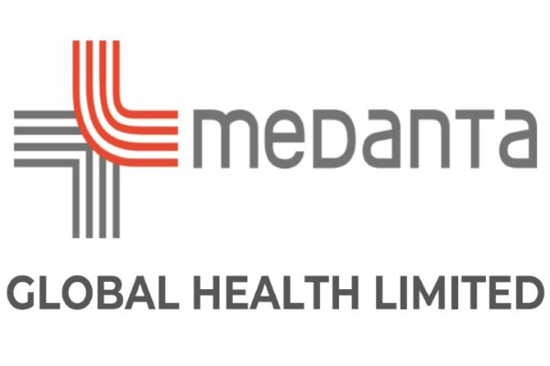
Radiology Film Digital Transformation – Medanta Hospital
About the Organization
Medanta Hospital, is one of India’s leading multi-specialty private hospitals, renowned for advanced medical care and world-class infrastructure.
Initiative: Green & Digital Transformation in Radiology
Department: Radiology Services
Solution: On-Demand Radiology Film Printing
Objective: Reduce printing waste, optimize operational efficiency, and support sustainability.
Why was a Digital Solution Required?
Eliminate unnecessary pre-printing.
Enable printing only when requested by patients or clinicians.
Reduce paper and printer consumable usage.
Improve operational efficiency.
Support Medanta's Green Hospital initiative.
Optimize printing cost without impacting patient care.
Digital Impact
Operational Improvements
Daily print volume reduced from 1,715 → 708
~1,007 fewer prints every day
Manual handling significantly reduced
Front desk storage dependency eliminated
Cost Efficiency
Significant reduction in paper consumption
Reduced toner and printer consumables
Lower operational printing costs
Quality & Sustainability
~59% reduction in printing volume
Nearly 59% elimination of report wastage
Supports Medanta's Green Hospital initiative
Earlier transition from film-based to paper-based printing had already eliminated hazardous film waste
Digital Tool / Solution Implemented
Medanta implemented an On-Demand Radiology Film Printing Solution, replacing the traditional pre-printing workflow with printing to a pdf file
Radiology films are now printed only upon request, ensuring resources are utilized efficiently while maintaining seamless patient service.
Key Features:
On-demand film printing
Zero pre-printing workflow
Print only when required
Integrated with Report Portal / EMR / Patient app
Reduced manual handling
Environment-friendly workflow
Digital Implementation Highlights
Successfully implemented across Radiology services
Printing shifted from Pre-Print → On-Demand
Staff trained on revised workflow
No impact on patient turnaround time
Seamless integration with existing workflow
Problem Statement / Digital Challenge
Large number of radiology films were printed before patient collection.
Significant number of printed films remained uncollected, resulting in paper and consumable wastage.
Increased operational effort for storage, handling and disposal.
Higher printing costs and environmental impact.
Digital Film availability
Notes:
Speaker notes
XXXXX
XXXXX
XXXXX
XXXXX
XXXXX
XXXXX
XXXXX
XXXXX
XXXXX

