Slide 1

Template for PSQ Indicators
This template is designed to help hospital track and monitor Patient Safety and Quality (PSQ) indicators within their healthcare facility. It provides a structured format to collect data on key performance metrics related to patient safety, clinical outcomes, and quality improvement efforts. The template allows hospitals to assess compliance , identify trends, measure progress, and ensure alignment with NABH standards. It serves as a critical tool for ongoing evaluation and strategic planning to enhance patient care and safety.
Document ID | EM/Template/01/V2.0
Document Category | Template
Version | 02
Issue Date | 05/2026

Slide 2
PATIENT SAFETY AND QUALITY INDICATORS TEMPLATE
NAME OF THE HOSPITAL:
DATE:

Slide 3
The Quality Indicators
Process Indicators
Outcome Indicators
Supplementary Managerial Indicators
Safe-surgery procedure compliance (wrong site / patient / surgery)
Safe & rational prescriptions
Incomplete / improper consent
Time taken for discharge
Time for initial assessment of indoor patients
Waiting time for outpatient consultation
Compliance to hand hygiene practices
Catheter-associated urinary tract infection (CAUTI) rate
Surgical site infection (SSI) rate
Incidence of medication errors
Incidence of patient falls
Mortality rate
Average Length of Stay (ALOS)
Hospital-associated pressure ulcers after admission
Employee attrition rate (category-wise)
Employee absenteeism rate
Employee satisfaction
Employees aware of rights & responsibilities
Prescribed NABH PSQ indicators should be monitored. Supplementary indicators may be added based on the organisation’s scope and operational needs.
Source: Template for PSQ Indicators • EM/FORMAT/06/V2.0 • Issue Date 05/2026

Slide 4
Name of the Quality Indicator (e.g. Patient Fall)
Numerator
Denominator
Formula
    Number of total Falls
    ---------------------------- x 1000
    Total Patient Days*
Total patient days is the total number of days a patient spends in a hospital during a specific period of time, from the day of admission to the day of discharge, but not including the day of discharge.

Slide 5
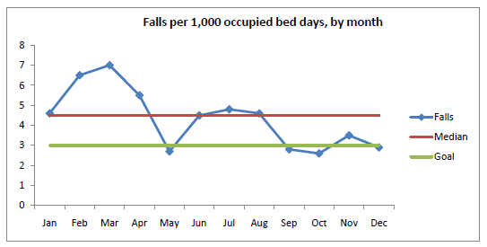
Patient Fall in the Hospital
Month | Apr’24 | May’24 | Jun’24 | Jul’24 | Aug’24 | Sep’24 | Oct’24 | Nov’24 | Dec’24 | Jan’24 | Feb’24 | Mar’24 | Total
No. of Falls
Patient Days
Fall Rate
Graphical representation of the indicator

Slide 6
Patient Fall in the Hospital – Analysis & Interpretation
Analysis: (possible causes, process deviation etc).
Note: A process that helps organisations investigate the cause of an incident, determine its impact, and identify strategies to prevent similar occurrences in the future .
**Analysis process is mentioned on the next slide.
Corrective Actions:
Note: A Corrective Action is a measure implemented in a workplace to combat the reoccurrence of incidents that may lead to injuries, destruction, and ruining the public image. It eliminates the root causes of problems that have already occurred.
Preventive Actions:
Note: Preventive action is a system to eliminate any cause(s) that would create a potential hazard or undesirable situation.

Slide 7
The steps of analysis may include:
Ascertaining that a serious clinical incident has occurred
Triggering the investigation procedure
Establishing the circumstances as they initially appear
Structured interviews of staff
Collating interviews and assembling composite analysis
Compiling report of events
Submitting report to senior clinicians and management
Implementing actions arising from report

Slide 8
THANK YOU

